Slide 1
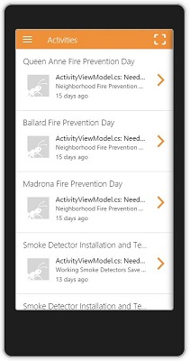


What is allReady?
Notes:
Topic: allReady is providing logistics and a platform for information feedback from disaster sites.

Slide 2
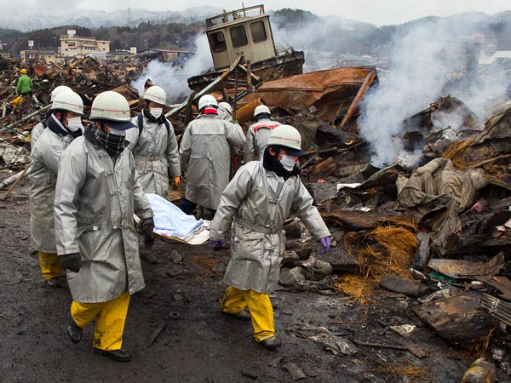
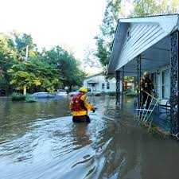
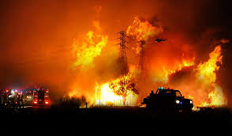
The motives
In every disaster scenario, new logistics are made to cope with the situation (non-immediate process).
Valuable (life-saving critical) time is wasted in this process
Notes:
Have this slide a bit messy, to send an vibes of unease at this topic

Slide 3

Solution
Save valuable time:
A pre-made infrastructure of information and logistics, ready to be used at the time of need. Collaboration is established with emergency services prior to the incident.

Slide 4
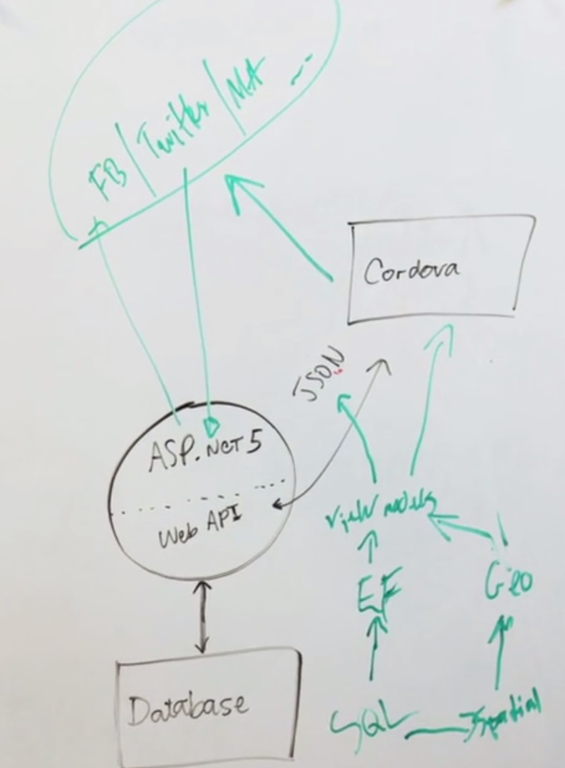
Model
Open Source
Developers:
Contributions from github community (through good will)
Core team, guided and adviced by Microsoft experts
Development tools:
Data is saved on Azure servers, donated by Microsoft
Developed on Visual Studio, and various additive tools, also dedicated to the good cause by Microsoft

Slide 5





Who?
Team
Backing
Contributing

Slide 6





Means
Platforms
Tools
In accordance with

Slide 7
Feasibility
Current Milestone is version 1.0, due July 3, 2017 (46% complete as of mid-June)
Far from complete and ready for demonstration.
“After v1.5, we will fix issues identified in testing as well as focus on mobile support & apps for allReady. This milestone is currently be built and issues are being collected so it may be sparse for now.”
Milestones page
Notes:
Not fully ready yet, fixing bugs found in tests

Slide 8
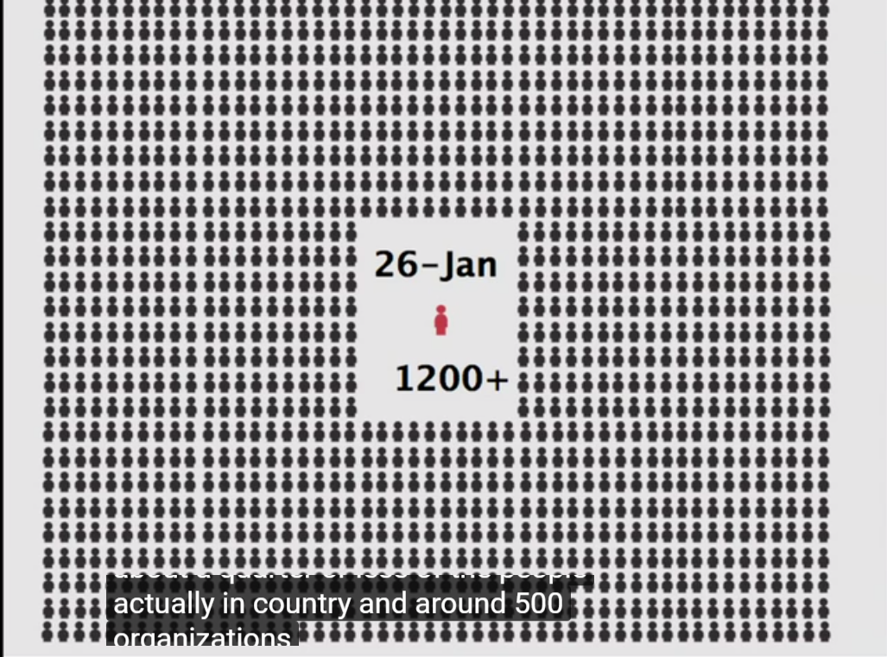

Feasibility
Though no demonstrations were made, the program does not lack the necessary backing for it to succeed.

Slide 9
Alternatives
InSTEDD
Integrated Public Alert & Warning System (IPAWS) OPEN
National EMS Information System (NEMSIS)
Open ISES
Ready.Gov
Real-time Outbreak & Disease Surveillance (RODS)
Sahana Foundation Projects
Society for Public Health Education (SOPHE)
TriSano
Ushahidi
WebEMS
Wireless Information System for Emergency Responders (WISER)
BioSense Project
Caribbean Disaster Emergency Response Agency (CDERA)
CDC Widgets & Gadgets
Countermeasure Tracking System (CTS)
Federal Emergency Management Agency (FEMA)
FrontlineSMS
Global Disaster Information Network (GDIN)
Health Alert Network (HAN)
HHS Office of Preparedness & Medical Emergency Response

